Slide 1
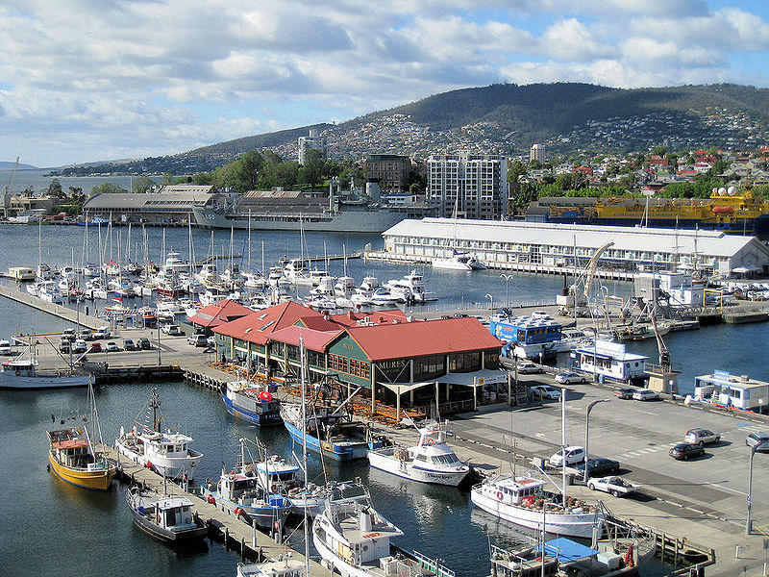
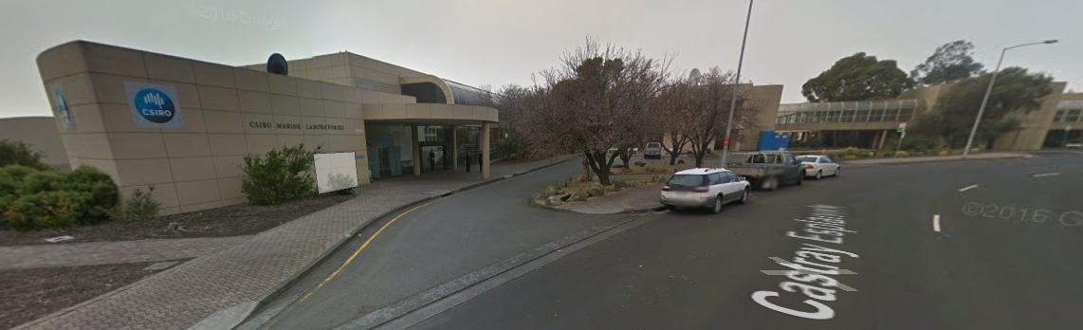
Day 1: Tuesday, 07 March 2017
Meeting commences at the CSIRO main building 08:45 (incl. registration)
  Castray Esplanade, Hobart. The CSIRO building is down the end of Castray Esplanade (away from Salamanca Place) as the road bends around to the right.
  See https://goo.gl/maps/ZPM5SgAnLqS2 or the image below.
The building should be accessible from 08:30. The meeting will be in the Auditorium near the front door
Tea and coffee on arrival
Morning Tea and afternoon tea provided
Lunch – own Arrangements, options nearby:
CSIRO canteen
Salamanca Place and
Salamanca Square many options
https://goo.gl/maps/h5nJuuHsmeP2

Slide 2
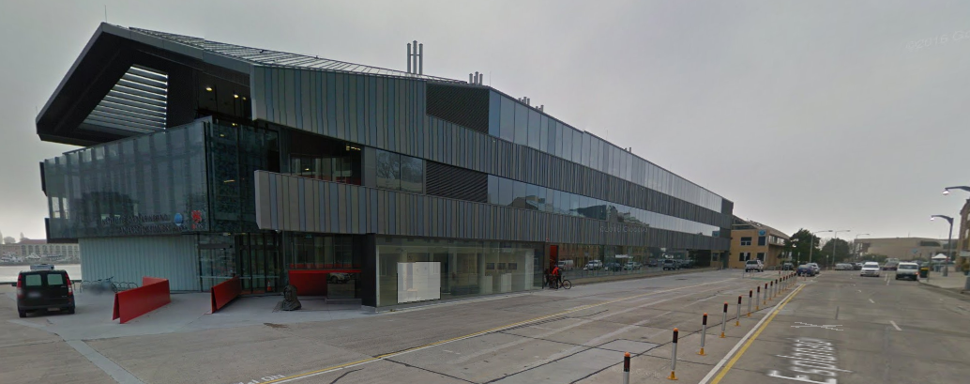
Day 2: Wednesday, 08 March 2017
Meeting commences at the IMOS Offices 09:00
  20 Castray Esplanade, Hobart. Look for Institute for Marine and Antarctic Studies IMAS/University of Tasmania UTAS signage above the main front door. See: https://goo.gl/maps/XF33SD8c9hG2 and image below
IMAS is a secure building, access only after 08:30, visitor sign-in will be required (staff will assist)
Tea and coffee on arrival from 0830
Morning Tea provided
Meeting breaks at 1200 for lunch and ship tours
Lunch – Own Arrangements, options nearby:
Salamanca Place and Salamanca Square many options
CSIRO canteen
Ship Tours – 1200-1400
Small group tours
Meeting recommences at CSIRO 14:00
Afternoon Tea provided
https://goo.gl/maps/hzsjZG3god62

Slide 3
Day 3: Thursday, 09 March 2017
Meeting commences at The Old Woolstore 09:00
  1 Macquarie Street Hobart.
Tea and coffee on arrival from 0830
Morning and Afternoon Tea provided
Lunch – Own Arrangements, options nearby:
- 2 Macquarie Street (over the road) Hogs Breath Cafe.
- Hunter Street - Saffron Indian, Jam Packed Café
- Constitution Dock - Mures Lower Deck, Mures Upper Deck, Various Fish Punts
Dinner
Hobart Function and Conference Centre from 1830 Elizabeth Street Pier
Three course dinner – RSVO final and fee already collected, drinks available for purchase from the Bar

Slide 4
Day 4: Friday, 10 March 2017
Meeting commences at The Old Woolstore 09:30
  1 Macquarie Street Hobart.
Tea and coffee on arrival
Morning Tea provided
Lunch
Own arrangements
Steering Committee
14:00 – 16:30 members only – held at CSIRO

